Slide 1
Synchronous Sequential Logic
Sequential Circuit is specified by a time sequence of inputs, outputs, and internal states
There are TWO main types of sequential circuits:
Asynchronous sequential circuit: Depends upon the input signals at any instant of time and the order in which the inputs change
Synchronous sequential circuit: is a system whose behaviour can be defined from the knowledge of its signals at discrete instants of time.

Slide 2
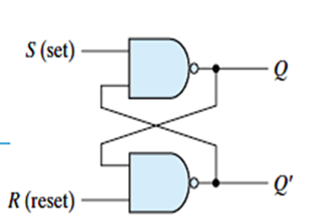
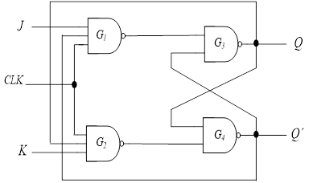
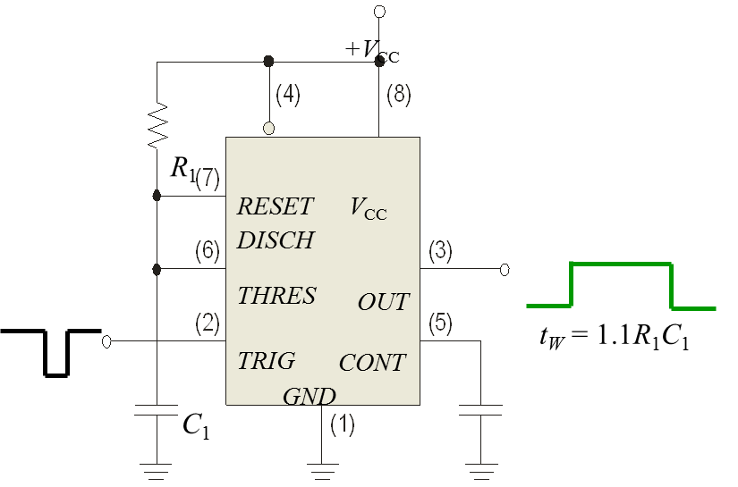
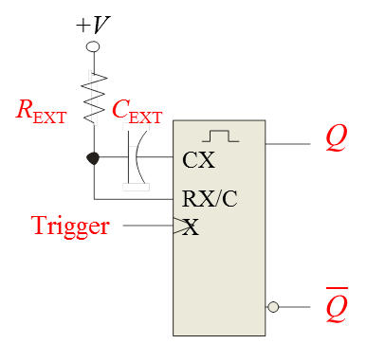
Multivibrator
Two-state devices called multivibrators are used extensively in digital electronics.
1.Bistable Monostable are called Flip-flops and are the basic memory devices used in sequential logic
2. Monostable Multivibrator ("one-shot" circuit) which can serve as a pulse source.
3. Astable Multivibrator which serves as an oscillator

Slide 3
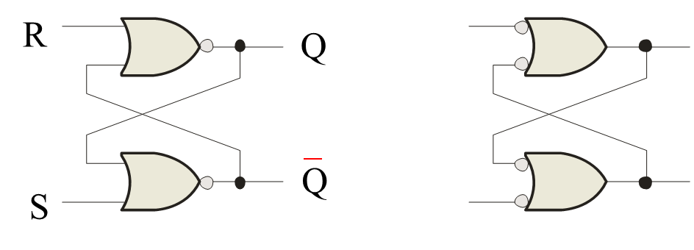
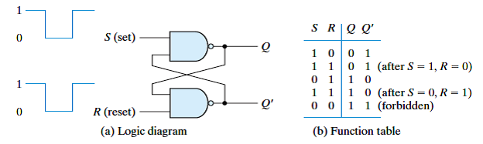
Flip-flops
Latches
A latch is a temporary storage device that has two stable states (bistable). It is a basic form of memory.
The S-R (Set-Reset) latch is the most basic type. It can be constructed from NOR gates or NAND gates. With NOR gates, the latch responds to active-HIGH inputs; with NAND gates, it responds to active-LOW inputs.
NOR Active-HIGH Latch NAND Active-LOW Latch

Slide 4
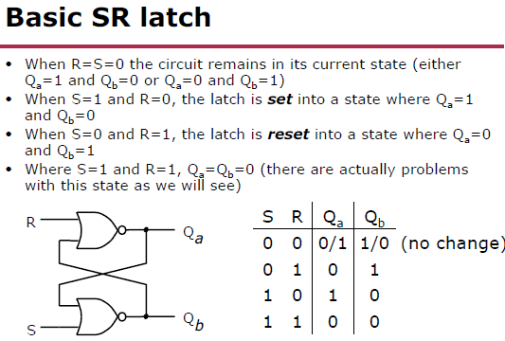

Slide 5
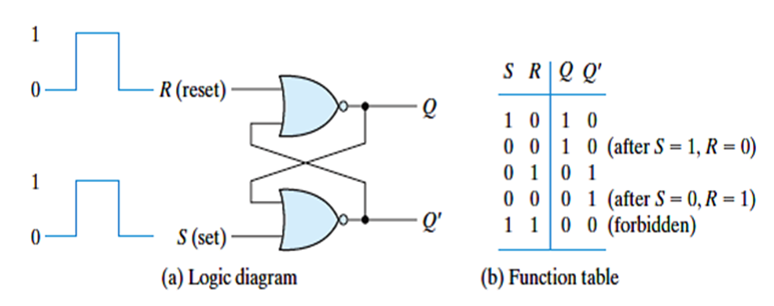
SR Latch

Slide 6
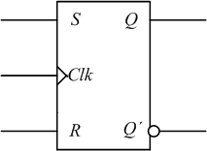
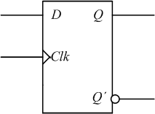
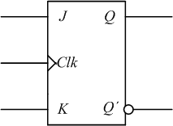
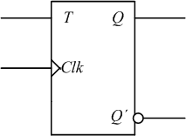
Flip-flops
A device that stores either a 0 or 1.
Stored value can be changed only at certain times determined by a clock input.
New value depend on the current state and it’s control inputs
A digital circuit that contains flip-flops is called a sequential circuit
S-R flip-flops
D flip-flop
J-K flip-flops
T flip-flop

Slide 7
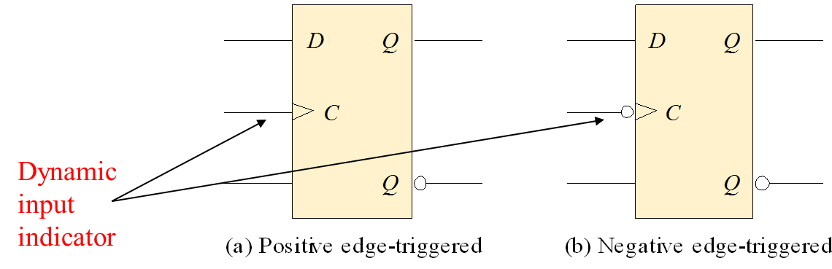
Flip-flops
Flip-flop :is a clocked device, in which only the clock edge determines when a new bit is entered.
Flip-flop differs from a latch in the manner it changes states.
The active edge can be positive or negative.

Slide 8
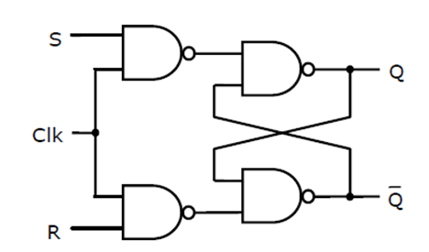
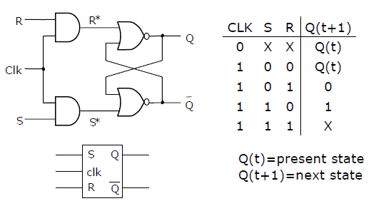
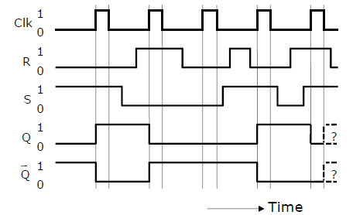
Gated SR latch timing diagram
OR

Slide 9
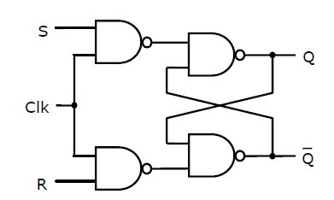
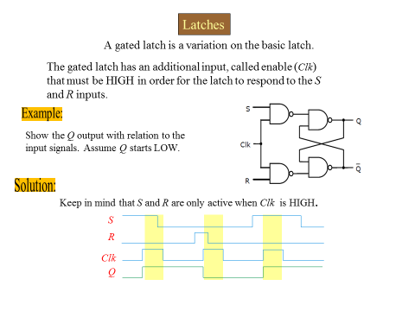
Latches
A gated latch is a variation on the basic latch.
The gated latch has an additional input, called enable (Clk) that must be HIGH in order for the latch to respond to the S and R inputs.
Example:
Show the Q output with relation to the input signals. Assume Q starts LOW.
Solution:
Keep in mind that S and R are only active when Clk is HIGH.

Slide 10
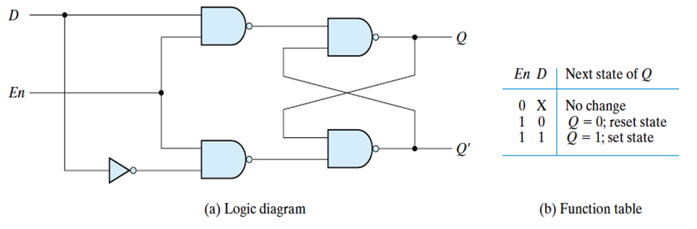
D Latches
The D latch is an variation of the S-R latch but combines the S and R inputs into a single D input as shown:
A simple rule for the D latch is: Q follows D when the Enable is active.

Slide 11
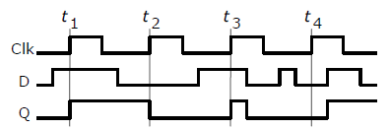
Example
D
Q
EN
Q
Notice that the Enable is not active during these times, so the output is latched.
The truth table for the D latch summarizes its operation. If EN is LOW, then there is no change in the output and it is latched.

Slide 12
Flip-flops
A D-flip-flop does not have a toggle mode like the J-K flip-flop, but you can hardwire a toggle mode by connecting Q back to D as shown. This is useful in some counters.
Q
For example, if Q is LOW, Q´ is HIGH and the flip-flop will toggle on the next clock edge. Because the flip-flop only changes on the active edge, the output will only change once for each clock pulse.
D
CLK
CLK
Q´
D flip-flop hardwired for a toggle mode

Slide 13
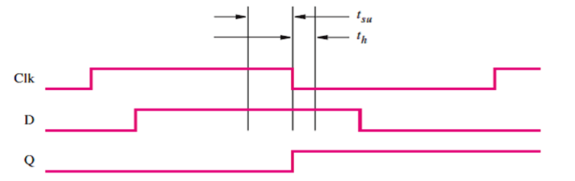
Effects of Propagation Delays
The minimum time that the D signal must be stable prior to the negative edge of the Clk signal is called the setup time, t_{su}, of the latch. The minimum time that the D signal must remain stable after the negative edge of the Clk signal is called the hold time, t_{h}, of the latch. The values of t_{su} and t_{h} depend on the technology used. Manufacturers of integrated circuit chips provide this information on the data sheets that describe their chips. Typical values for CMOS technology are t_{su} = 3 ns and t_{h} = 2 ns.

Slide 14
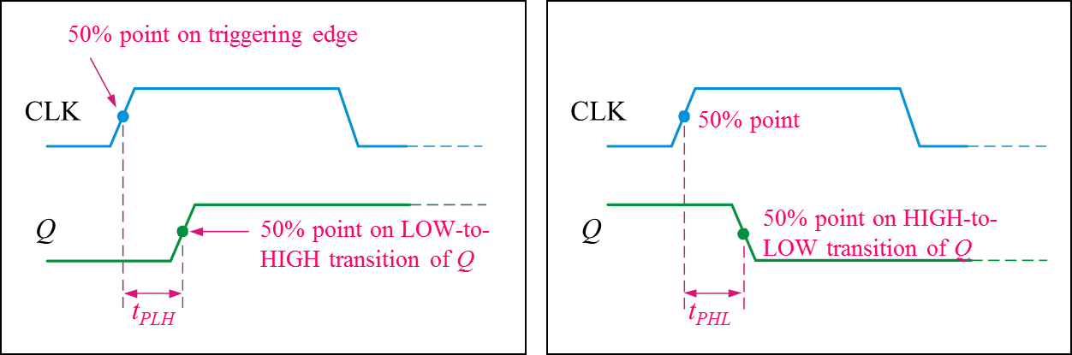
Flip-flop Characteristics
A flip-flop is a storage element based on the gated latch principle, which can have its output state changed only on the edge of the controlling clock signal. We considered two types:
• Edge-triggered flip-flop is affected only by the input values present when the active edge of the clock occurs.
• Master-slave flip-flop is built with two gated latches. The master stage is active during half of the clock cycle, and the slave stage is active during the other half.
Propagation delay time is specified for the rising and falling outputs. It is measured between the 50% level of the clock to the 50% level of the output transition

Slide 15
J-K flip-flop
Q
J
CLK
K
Q
The J-K flip-flop is more versatile than the D flip flop. In addition to the clock input, it has two inputs, labeled J and K. When both J and K = 1, the output changes states (toggles) on the active clock edge (in this case, the rising edge).

Slide 16
Flip-flops
Example
Determine the Q output for the J-K flip-flop, given the inputs shown.
J
Q
CLK
K
Q
Solution
Notice that the outputs change on the leading edge of the clock.
CLK
J
K
Q

Slide 17
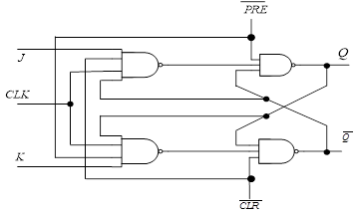
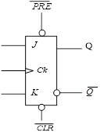
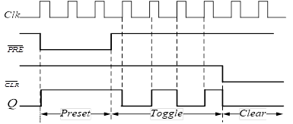
Asynchronous Preset and Clear Inputs Flip-flop
Asynchronous, meaning they affect the output independent of the clock. Two such inputs are normally labeled preset (PRE) and clear (CLR). These inputs are usually active LOW. A J-K flip flop with active LOW preset and CLR is shown
Example

Slide 18
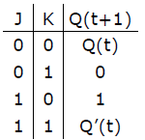
Flip-flops
Example
Determine the Q output for the J-K flip-flop, given the inputs shown.
PRE
J
Q
CLK
Q
K
Solution
Set
Toggle
Set
Reset
Toggle
Latch
CLR
CLK
J
K
Set
PRE
Reset
CLR
Q

Slide 19
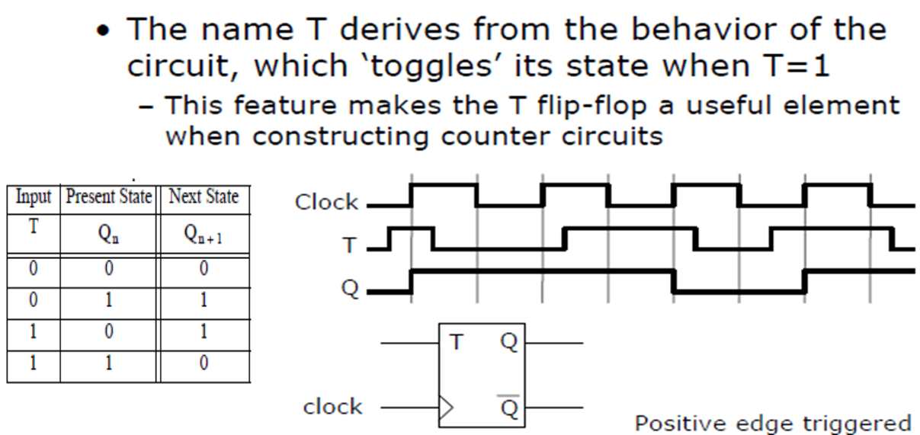
T Flip-flops

Slide 20
Master / Slave JK Flip Flops
Clk { HIGH = Master enable; Slave isolate }
Clk { HIGH = Master isolate; Slave enable }
(Clk) High,

